Slide 1
TEAM RM
“If you make a sale, you can make a living. If you make an investment of time and good services, you can make a fortune.”

Slide 2


KRISHNA LUHARUKA
SHREYA BHARATI
BIPIN TIMILSINA
SANDHYA BARAL

Slide 3
Did you know that 20% of your current customers will account for 80% of company's future revenue?

Slide 4

Average company loses between 10-30% of its customers every year!

Slide 5
How do companies lose their customers? -Fragmentation of markets -more demanding customers -rapidly changing buying patterns -intense global markets

Slide 6

It costs five times more to acquire new costumers than costs involved in retaining current customer.

Slide 7
This is where relationship marketing comes in! Enduring relationships with customers cannot be duplicated by competitors, and therefore provide for a unique and sustained competitive advantage.

Slide 8
AGENDA
Concept of Relationship Marketing
Relationship marketing vs Traditional Marketing
Practices done for Relationship Marketing
Relevance of Relationship Marketing
Challenges in Relationship Marketing
Real life examples

Slide 9
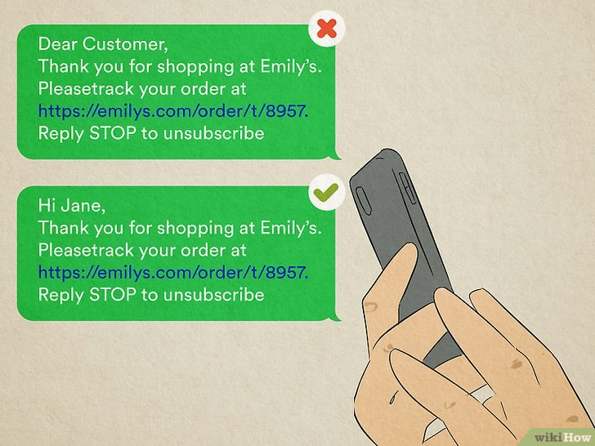
Relationship marketing
Focuses on building long-term relationships with customers.
Creating meaningful connection with the customers.
Emphasizes on customer satisfaction and retention.
Personalized approach to marketing.
Creates customer loyalty and advocacy.
Increase customer lifetime value.

Slide 10
Relationship MARKETING vs traditional marketing
Traditional Marketing | Relationship Marketing
Acquisition of new customers. | Retention of existing customers.
Little emphasis on customer services. | High customer service emphasis.
Low brand loyal customer. | More brand loyal customer.
A quick one time gain. | Long term business results.
.

Slide 11
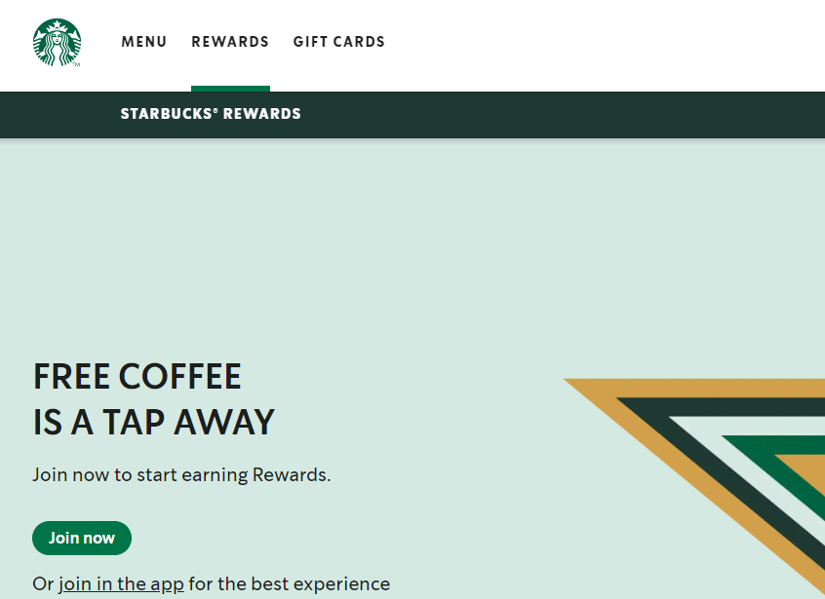

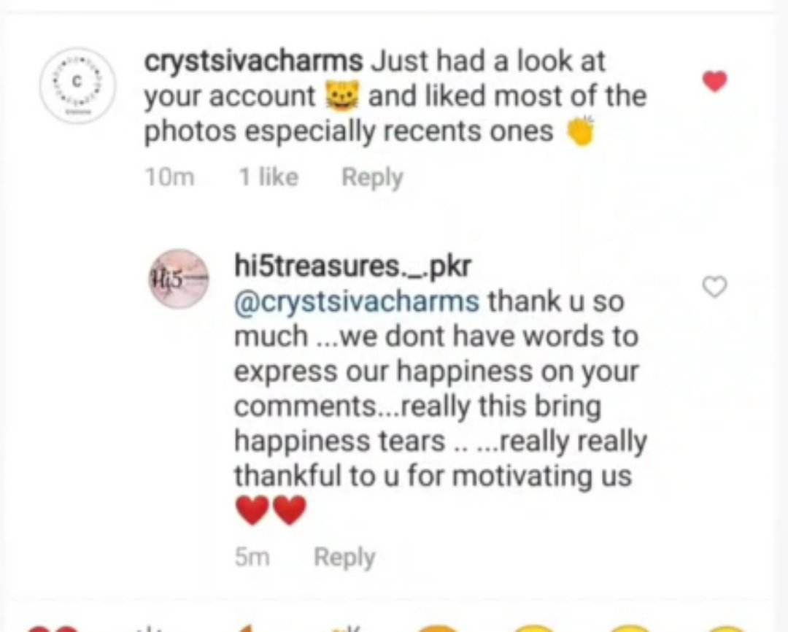
Practices:
Loyalty programs
Over-the-top customer service
Community Building.
Photo by Pexels

Slide 12

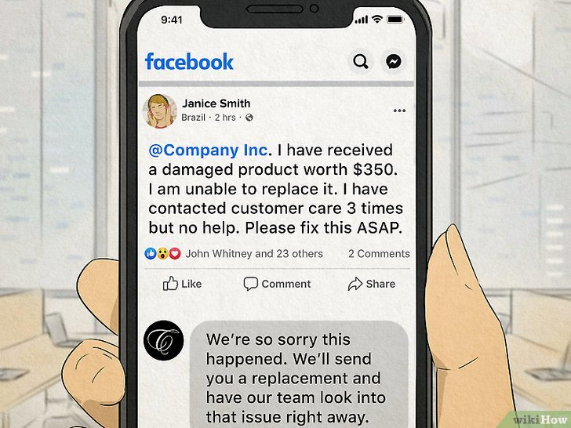

Complementary products
Personalized Communication
Feedback as marketing tool

Slide 13


Relevance
Identifies and addresses customer needs.
Enhance customer lifetime value.
Building long-term customer loyalty.
Creates brand loyalty and advocacy.
Reduces customer acquisition costs.
Increases profitability.

Slide 14

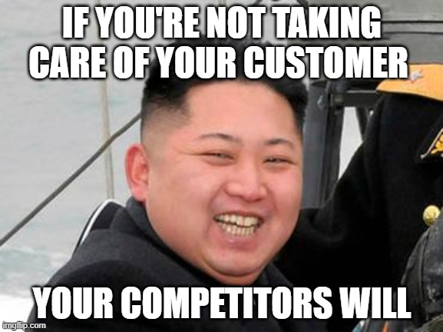
Challenges of Relationship Marketing
Time and resources needed.
Difficulties in measuring customer loyalty and ROI.
Inability to satisfy customer's unique preferences.
Competition and increasing customer expectations.
Responding to customers questions quickly.
Dealing with the complex software tools.
Photo by Pexels

Slide 15
Real life Example of Relationship Marketing
Sport Co.
Restaurant
Online Store
Tech Co.
Drinks Co.
Gift Shop

Slide 16




